Slide 1

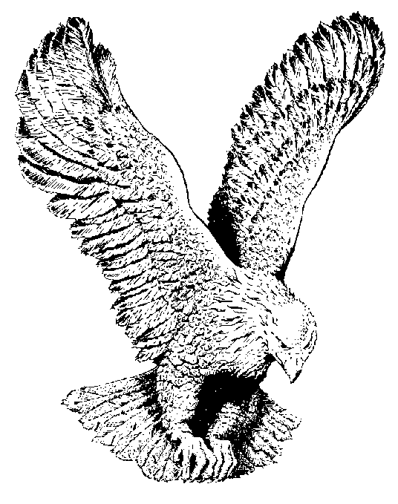
540 ARISE, SHINE
Arise, shine! For thy Light is come (2x)
And the glory of the Lord is risen,
The glory of the Lord is come
The glory of the Lord is risen upon thee.

